Slide 1
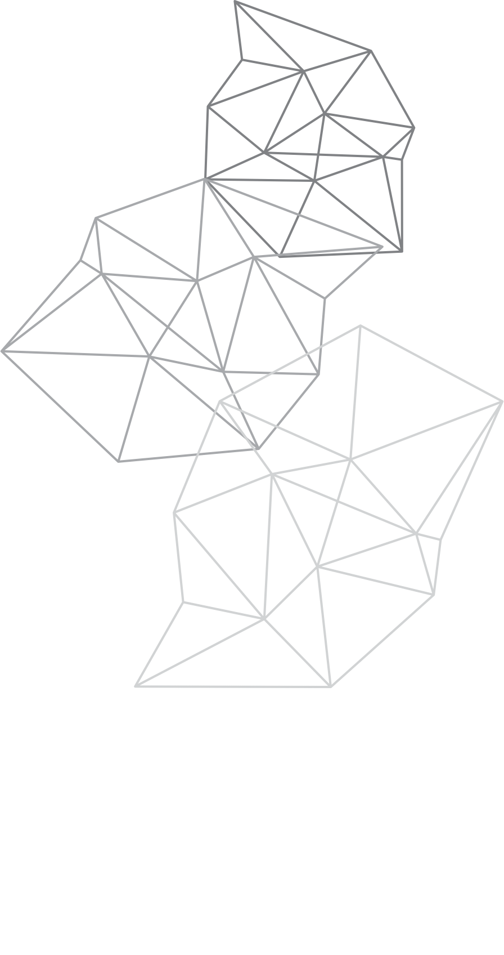

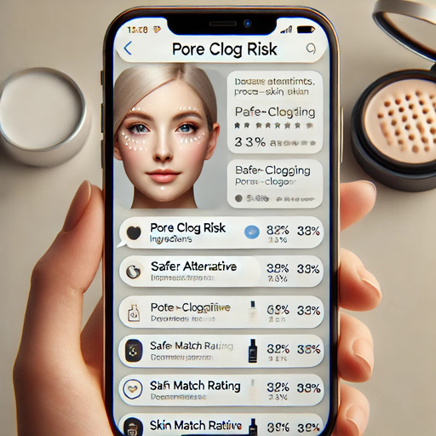
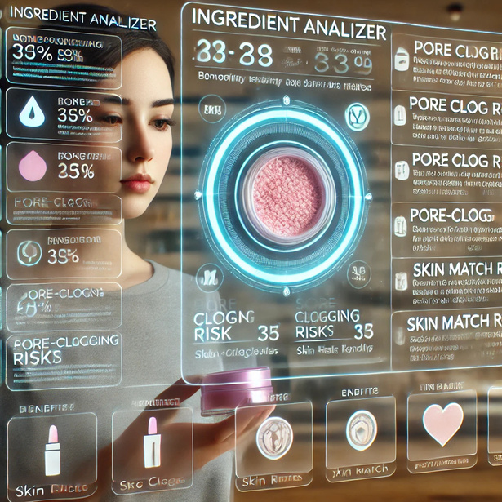

Makeup Ingredient Analyzer
By: Alondra Sanchez & Esmeralda Melendez
The Makeup Ingredient Analyzer is a tool-like bot designed to help users understand the composition of their cosmetic products and pore-clogging ingredients. Analyzing the ingredients listed on makeup labels provides detailed information about each ingredient, including its purpose (e.g., moisturizer, tint), potential benefits, possible risks (e.g., pore cloggers or irritants), and product-to-product & product-to-skin match (e.g., silicone vs. water-based and dry vs. oily skin type, respectively). The tool aims to promote safer and more informed cosmetic choices by educating users about what they're applying to their skin.

